Slide 1
Digital Trust Unlocker Simplifying Terms and Conditions
Protecting Privacy with Transparency
Digital Trust Unlocker
Saranya Manikandan
Master’s Student
Dept. of Software Engineering
Jeonbuk National University

Slide 2

The Challenge of Data Privacy
Increased Risk
Data theft is a growing threat
Hidden threat
Unlike physical theft, data theft can be undetectable.
Deceptive Practices
Sneaky methods (unknown links, untrusted apps) steal data.
Privacy vulnerability
This puts our privacy at significant risk.

Slide 3
Challenge of Unclear TERMS & CONDITIONS
Lack of Transparency
Long, complex T&Cs in third-party apps
Users accept T&Cs without understanding
Potential compromise of user information confidentiality
Difficulty understanding data access and usage
Burden
Uniformed consent
Privacy Risk

Slide 4
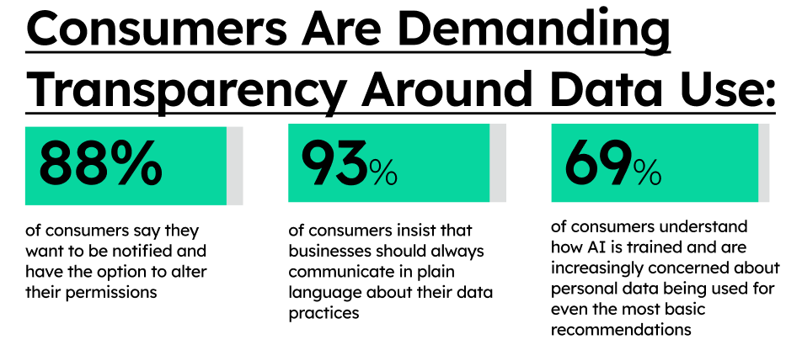
Consumer demand for Data transparency
Notes:
Source: https://news.ethicaltechproject.com/p/transparency-in-the-ai-era-a-demand

Slide 5
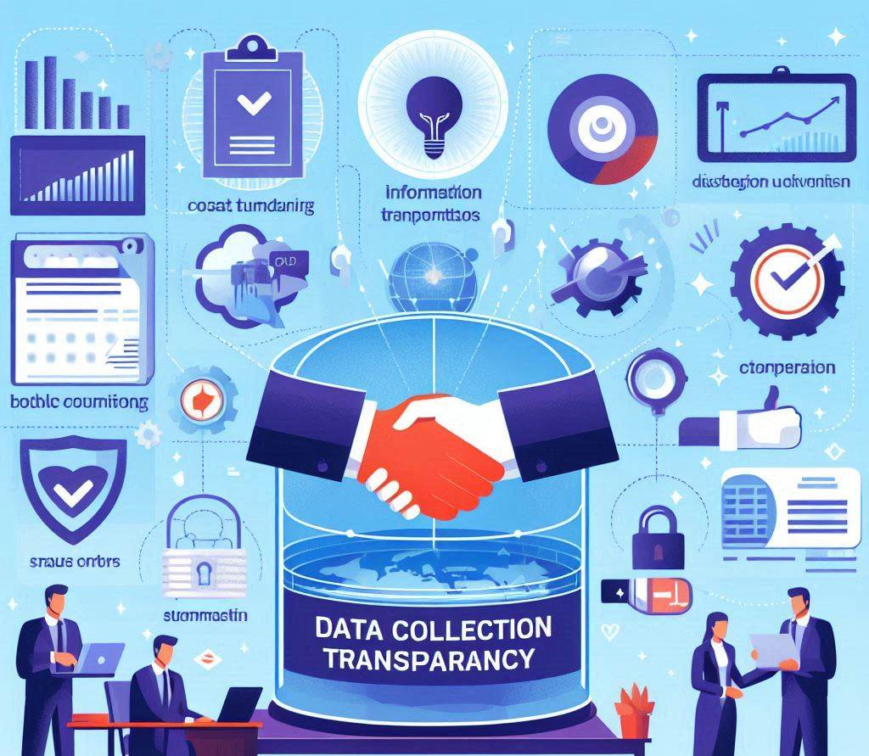
Empowering Users Through Transparency
Data collection transparency builds trust by informing customers about what data is collected and how it's used in simple manner.

Slide 6
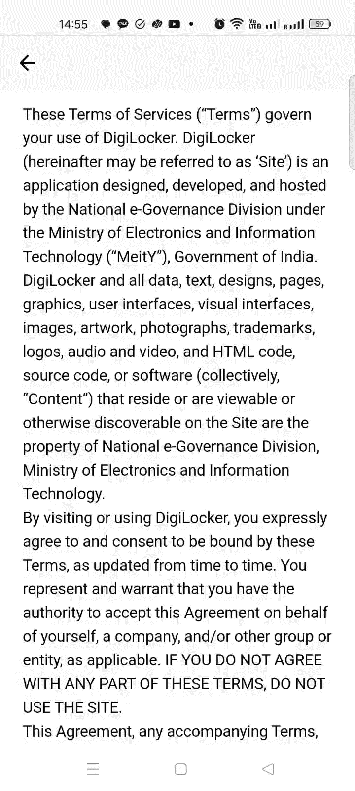
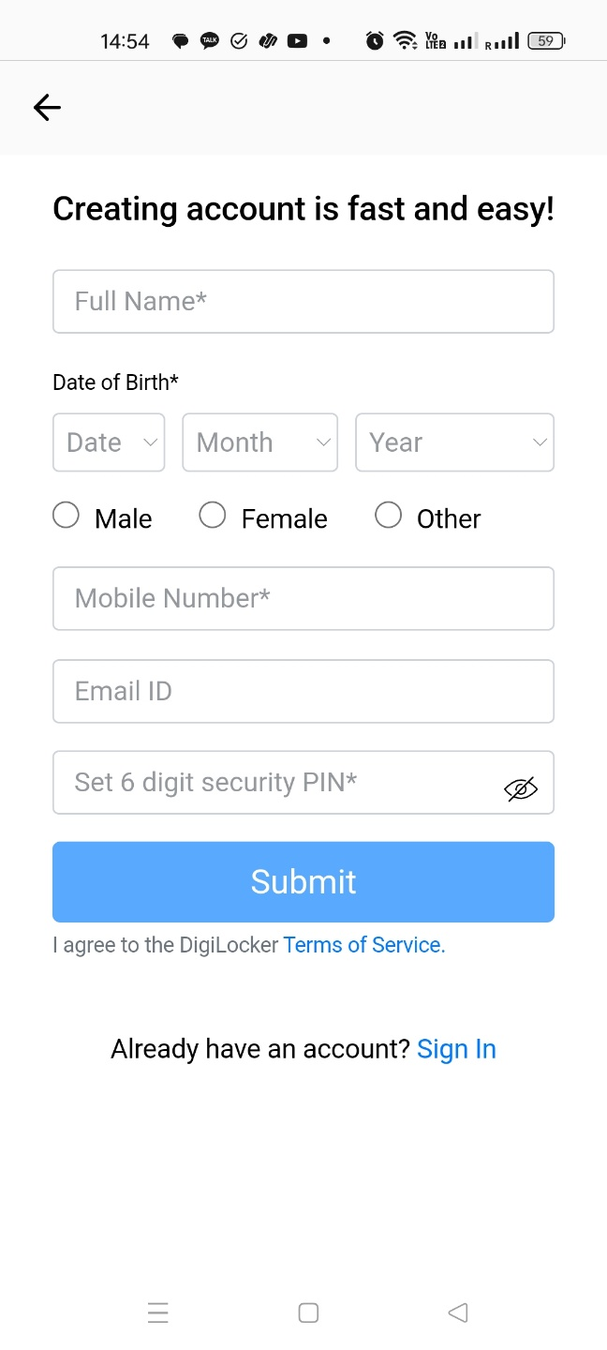
REAL SCENARIO

Slide 7
Digital Trust Unlocker
Mobile Application
Key Point Summaries
This app would provide key point clear summaries of key points within app T&Cs.
Crisp Understanding
Users would gain a crisp understanding of the data an application seeks to collect, empowering them to make informed decisions before sign in .
To combat unclear T&Cs, we propose mobile app, that simplifies complex legal jargon.

Slide 8
Application’s Key Features
Digital Trust Unlocker
T & C Summarization
Alerts for critical Data Collection
Provides Suggestion
Preferred Language

Slide 9



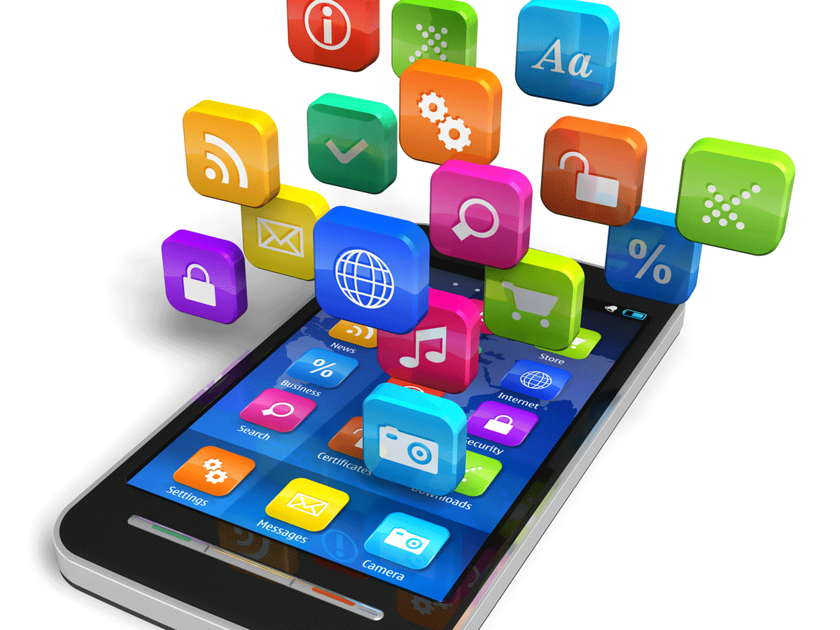

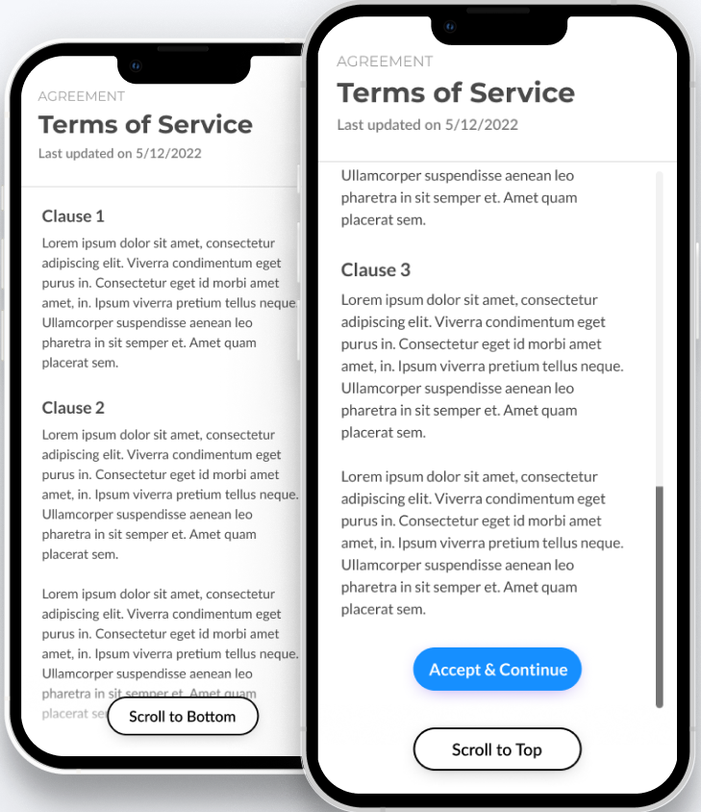


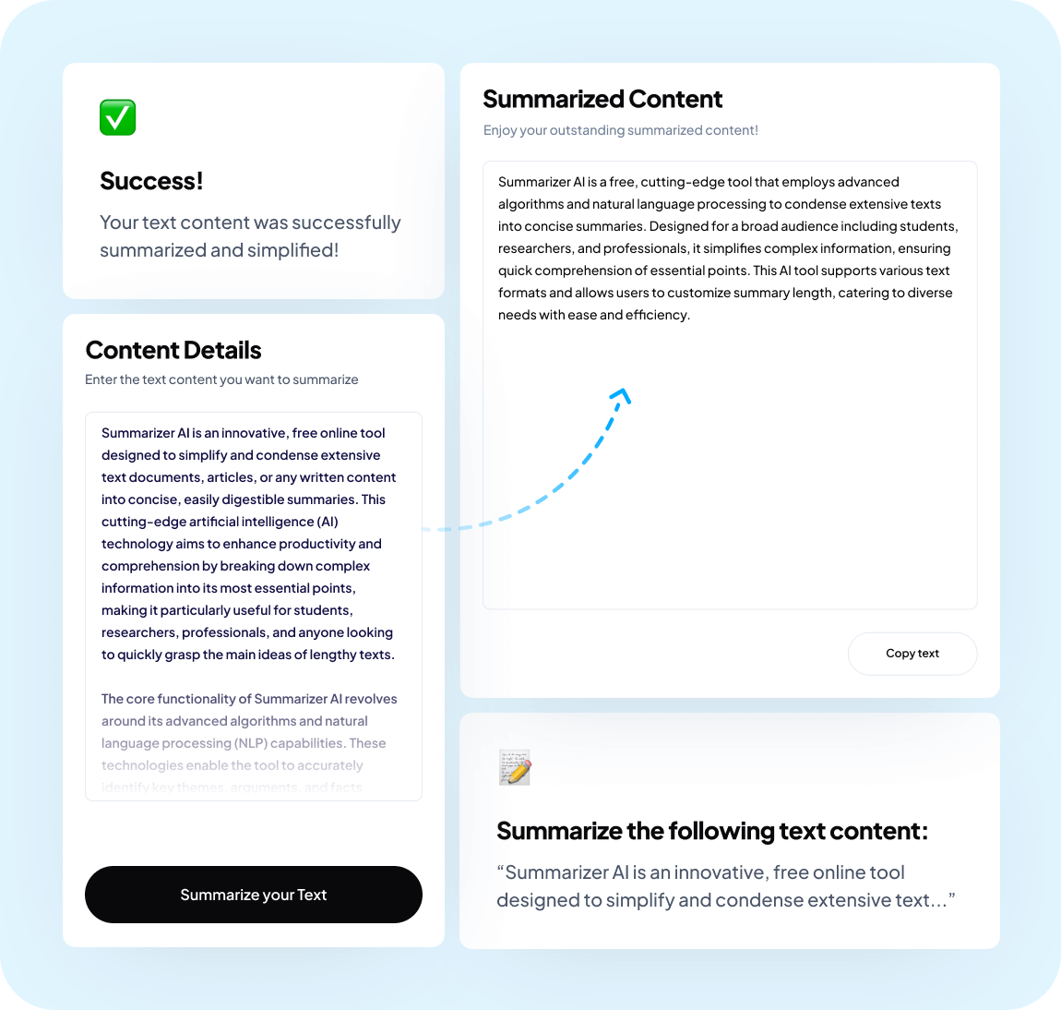


Application Overview
New
App
User
Lengthy
T & C
Digital Trust Unlocker
Summarized
T & C
Decision

Slide 10
Launching and Scaling Up
Target Audience : Android users, privacy-conscious individuals
Freemium Model for entry Basic features free, advanced features paid
Marketing Strategy
Social Media Marketing
content marketing
Influencer partnership.

Slide 11

Team Members
App Developer
ML/NLP engineer
UI/UX Designer
Project Lead
Product
Manager
Marketing
Specialist

Slide 12
Thank You

